Slide 1

Easy Data Capture Tool for Rapid Response Teams
Team 23
Data and Reporting
Accurate... Fast... Lifesaving.

Slide 2
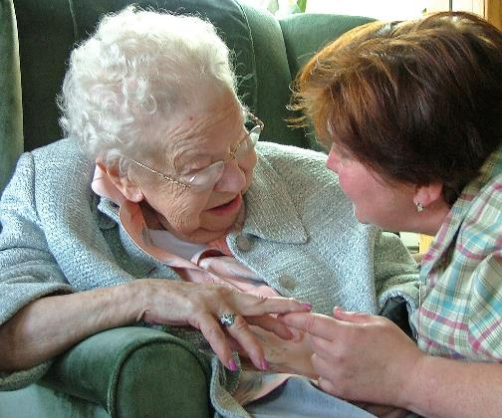
Storytelling
Susie is worried about her mother's breathing, and the nurse is busy in another room.
?...

Slide 3
Problem Statement
Inefficient communication when initiating a Rapid Response
leads to delays
which cost lives and cost money

Slide 4
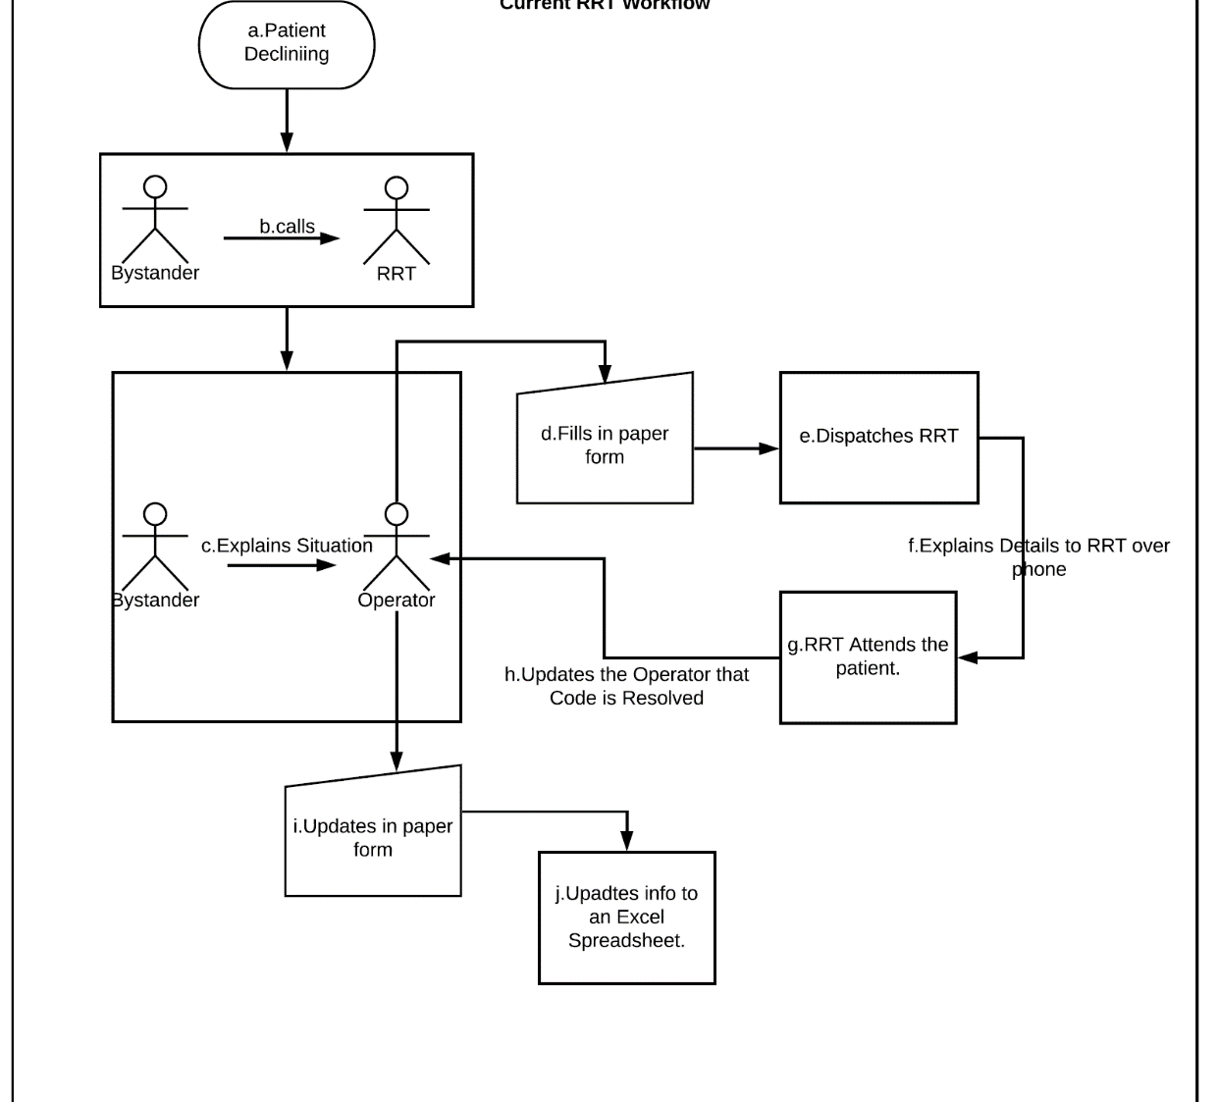
Current Workflow
Notes:
Involves multiple phone conversations and information exchanges.

Slide 5

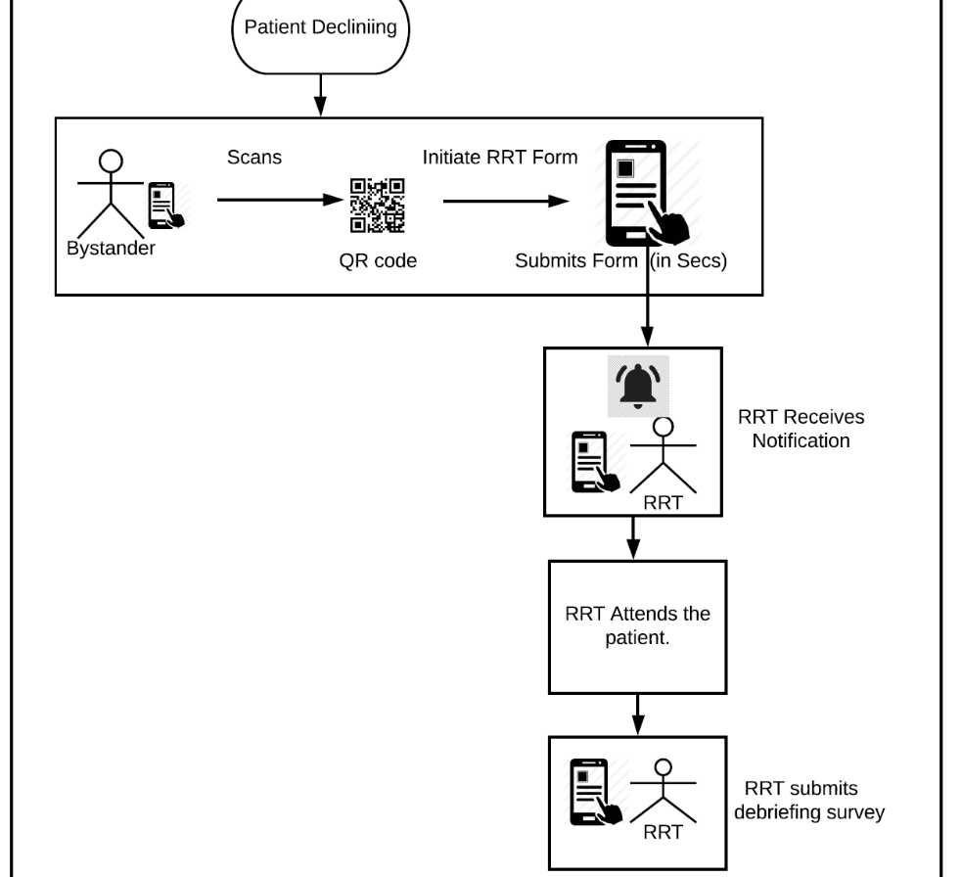
Proposed Workflow

Slide 6
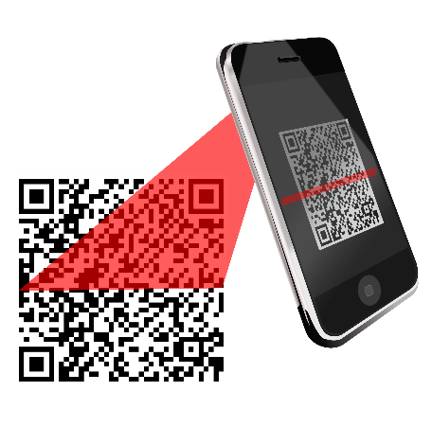
Storytelling
Susie scans the QR code on the wall beside the bed to initiate a rapid response.

Slide 7
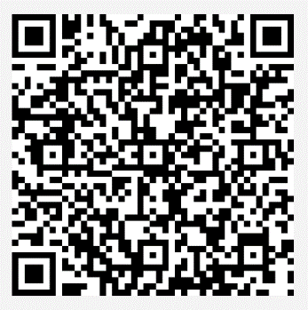
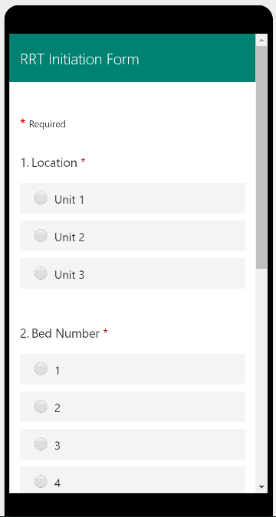

Demo
Watch how in less than 3 seconds the Rapid Response can be initiated at the bedside by anyone scanning a Microsoft Forms QR code.
Accurate... Fast... Lifesaving.

Slide 8


Benefits
Patients and Family
Satisfaction of patients and families​
Reducing noise no overhead paging​
Promotes empowerment
Notes:
HCAHPS scores

Slide 9

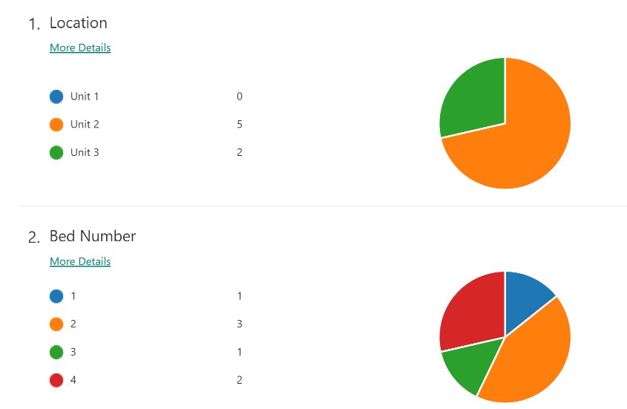
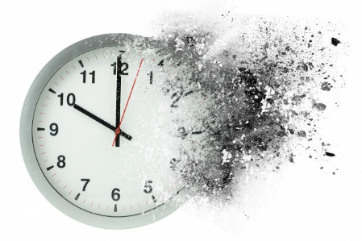
Benefits
Healthcare Team
Time is precious for declining patients (secs save lives)
COVID-19 patients can deteriorate very quickly​
HCAHPS increase
Accurately debrief
Notes:
HCAHPS scores

Slide 10

How can this solution be delivered?
As Is. This is a minimally viable product
Now in all Healthcare organizations
Packaged as a bot or app in Microsoft Teams
When will this solution be needed?
How could this solution evolve?

Slide 11

Storytelling
Because Susie could initiate the Rapid Response quickly, her mother's condition improved.

Slide 12

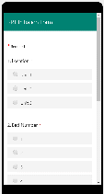

We are a united team of hackers!
Easy Data Capture Tool for Rapid Response Teams
Cory Stephens
Blanca Badgett
Kalpana Mandal
Sibgha Mirza
Madhuri Puli
Debra Cassidy
Jessica Liston
Team 23
1.
2.
3.
Notes:
HCAHPS – CMS reimbursement (noise reduction)
Reduction in morbidity and mortality
Debriefing and analysis to improve Rapid Response

